Slide 1
Data Visualizations using Line Chart Data
File created on: 2/28/2025
By
B. Bindu Gayatri

Slide 2
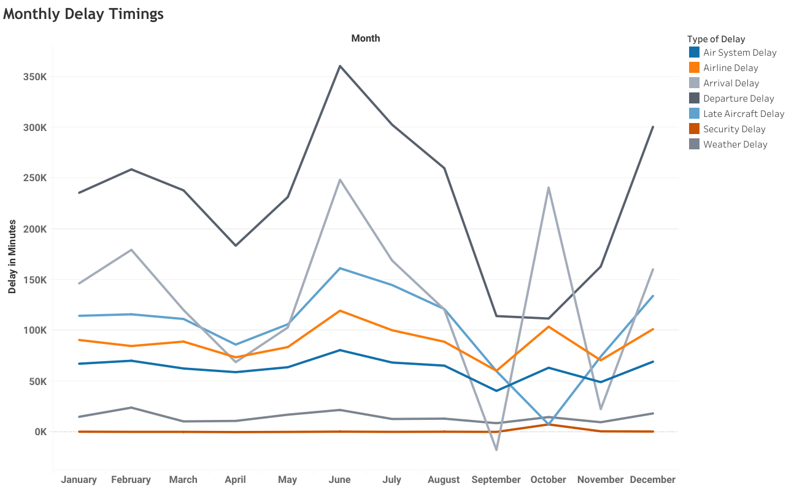

Slide 3
